Slide 1

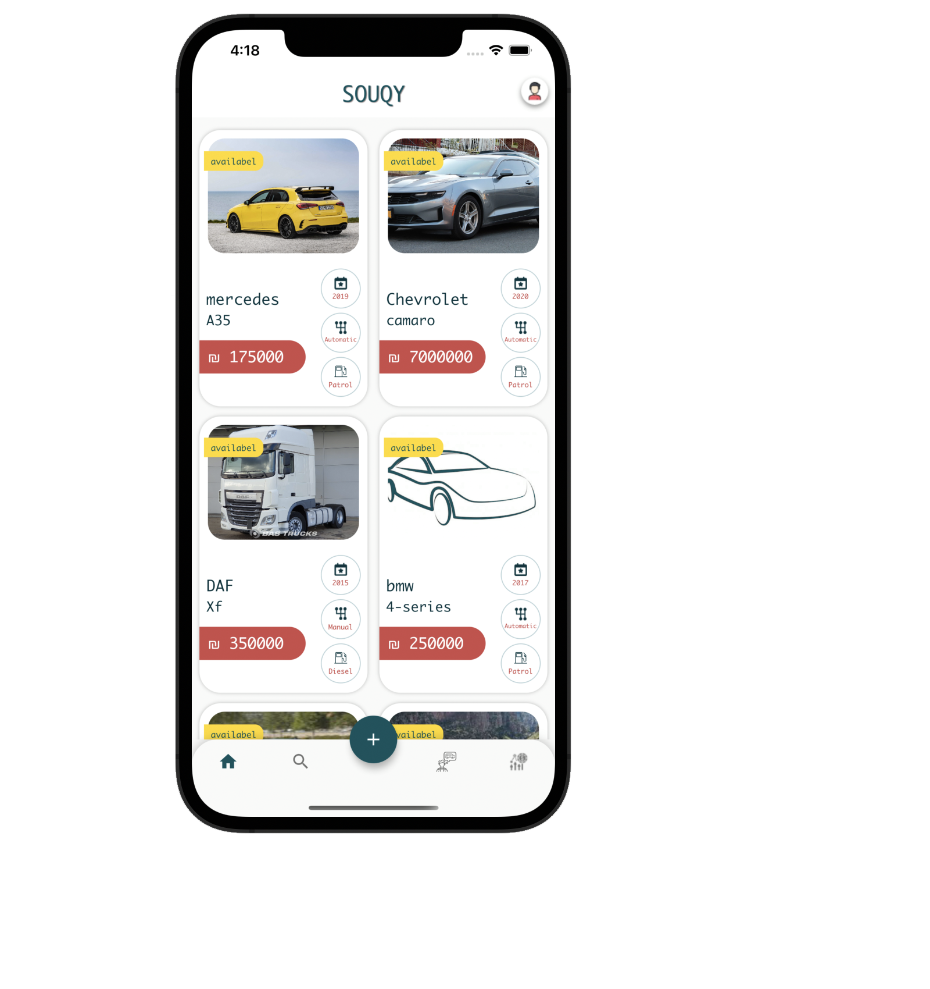
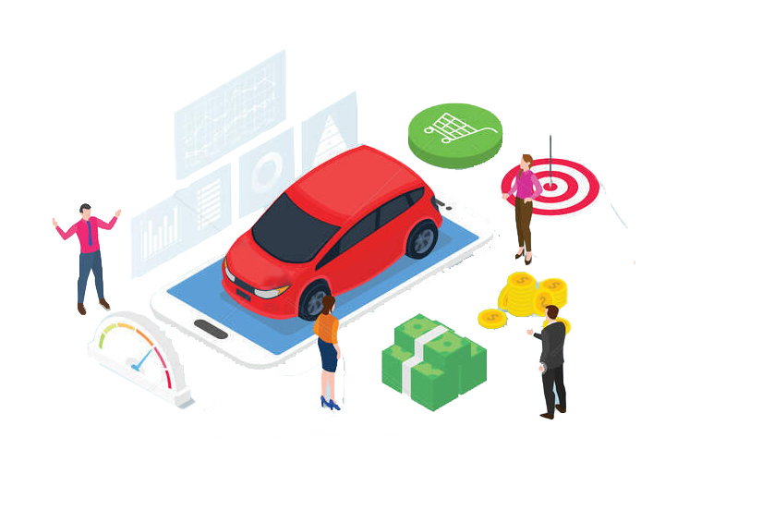
Vehicle Price Prediction Using Machine learning and Neural Networks - SOUQY APP

Slide 2
INTRODUCTION
In the last five years, Palestine has seen an increase in the field of Selling and trading vehicles. This matter has pushed many people to buy a vehicle, but because a lack of experience among people as the process of buying requires effort and knowledge from a technical expert and because there are several factors that affect the real price of the vehicle. We suggest in this project several machine learning techniques that obtain an approximate value for the vehicle price so that the person knows the amount of money that he must spend and why there’s a difference between prices for the vehicle from the same class. after that, we decide to create a Mobile application that used to facilitate the process for buying and trading the car and integrate this project with ML model

Slide 3
Goals
The Goals for this application:
Machine learning
Application - SOUQY

Slide 4
RELATED WORK
There's a lot of similar researches that deal with some problem done on the world
This project is the first project in Palestine
There's a huge number of data and features that deal with
It simulates a real problem that faces people every day and facilitates it

Slide 5





RoadMap
Before start
PHASE 1
PHASE 2
PHASE 3
Research
Data collection
Machine learning
Application
Web scraping
Research
Machine learning
Application
Data cleaning

Slide 6

PHASE 1
Web Scraping
Data Cleaning

Slide 7

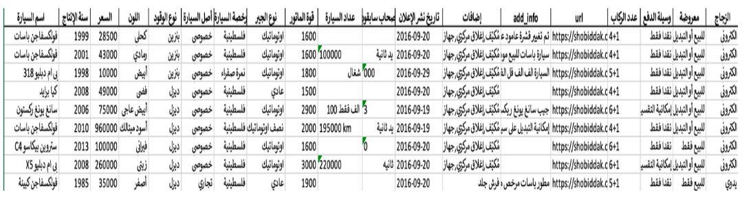
Web Scraping
Row: 212517
Column: 19

Slide 8
Data Cleaning and preprocessing
Color
Remove noise
Color
01
03
05
07
Previous owners
passenger
kilometers
Car name
02
04
06
08
01
Accessories
Day life

Slide 9
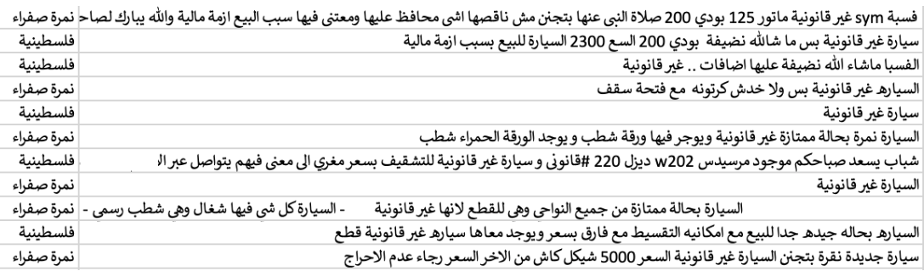
Remove noise in data

Slide 10
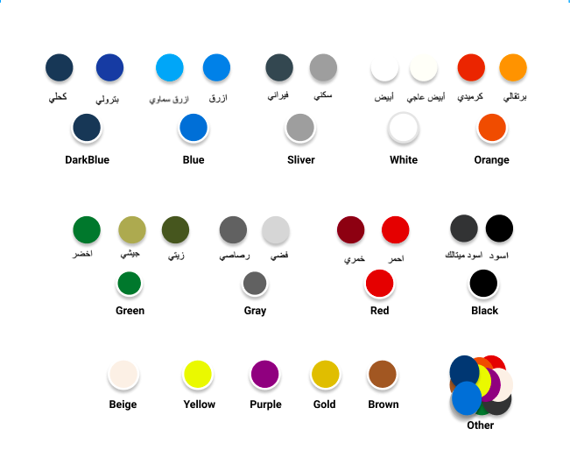
Color column

Slide 11
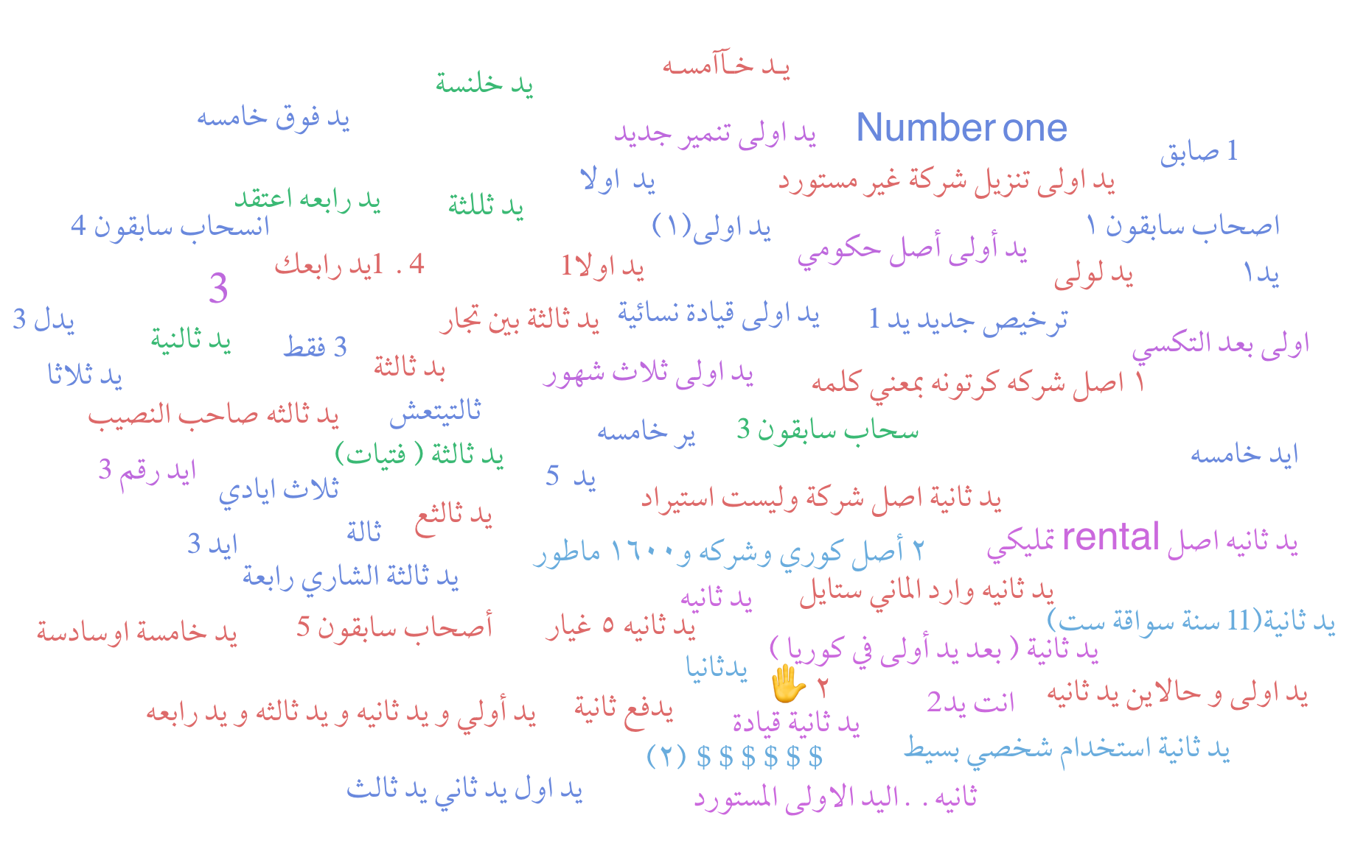
previous owner

Slide 12
passenger

Slide 13
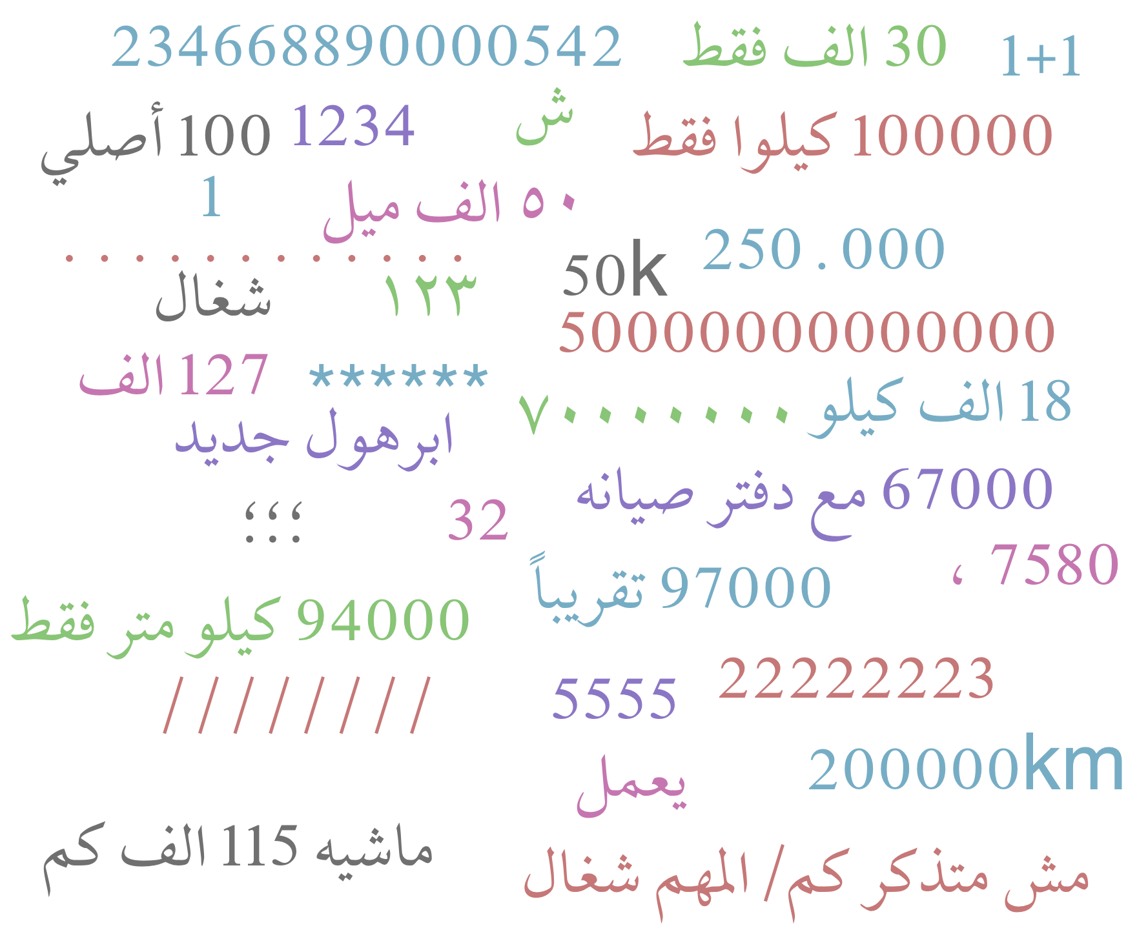
Kilometer
Remove number contain symbol.
Remove Unreasonable symbol.
Remove Unreasonable number.
Remove wrong sentence .
Remove الف .
Remove Unit (كم ,ميل ,كيلو ).
convert Arabic number to English number

Slide 14
Kilometer
Remove number contain symbol.
Remove Unreasonable symbol.
Remove Unreasonable number.
Remove wrong sentence .
Remove الف .
Remove Unit (كم ,ميل ,كيلو ).
convert Arabic number to English number

Slide 15
Kilometer
Remove number contain symbol.
Remove Unreasonable symbol.
Remove Unreasonable number.
Remove wrong sentence .
Remove الف .
Remove Unit (كم ,ميل ,كيلو ).
convert Arabic number to English number

Slide 16
Kilometer
Remove number contain symbol.
Remove Unreasonable symbol.
Remove Unreasonable number.
Remove wrong sentence .
Remove الف .
Remove Unit (كم ,ميل ,كيلو ).
convert Arabic number to English number

Slide 17
Kilometer
Remove number contain symbol.
Remove Unreasonable symbol.
Remove Unreasonable number.
Remove wrong sentence .
Remove الف .
Remove Unit (كم ,ميل ,كيلو ).
Remove any extra word.
convert Arabic number to English number

Slide 18
Kilometer
Remove number contain symbol.
Remove Unreasonable symbol.
Remove Unreasonable number.
Remove wrong sentence .
Remove الف .
Remove Unit (كم ,ميل ,كيلو ).
Remove any extra word.
convert Arabic number to English number

Slide 19
Kilometer
Remove number contain symbol.
Remove Unreasonable symbol.
Remove Unreasonable number.
Remove wrong sentence .
Remove الف .
Remove Unit (كم ,ميل ,كيلو ).
Remove any extra word.
convert Arabic number to English number

Slide 20
Kilometer
Remove number contain symbol.
Remove Unreasonable symbol.
Remove Unreasonable number.
Remove wrong sentence .
Remove الف .
Remove Unit (كم ,ميل ,كيلو ).
Remove any extra word.
convert Arabic number to English number

Slide 21
Kilometer
Remove number contain symbol.
Remove Unreasonable symbol.
Remove Unreasonable number.
Remove wrong sentence .
Remove الف .
Remove Unit (كم ,ميل ,كيلو ).
Remove any extra word.
convert Arabic number to English number .

Slide 22
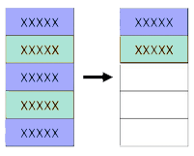
Car name
the process was done in 3 steps as follow:
Remove Duplicate :
we create a separate copy from the data and remove all
duplicate rows in the vehicle name column.

Slide 23
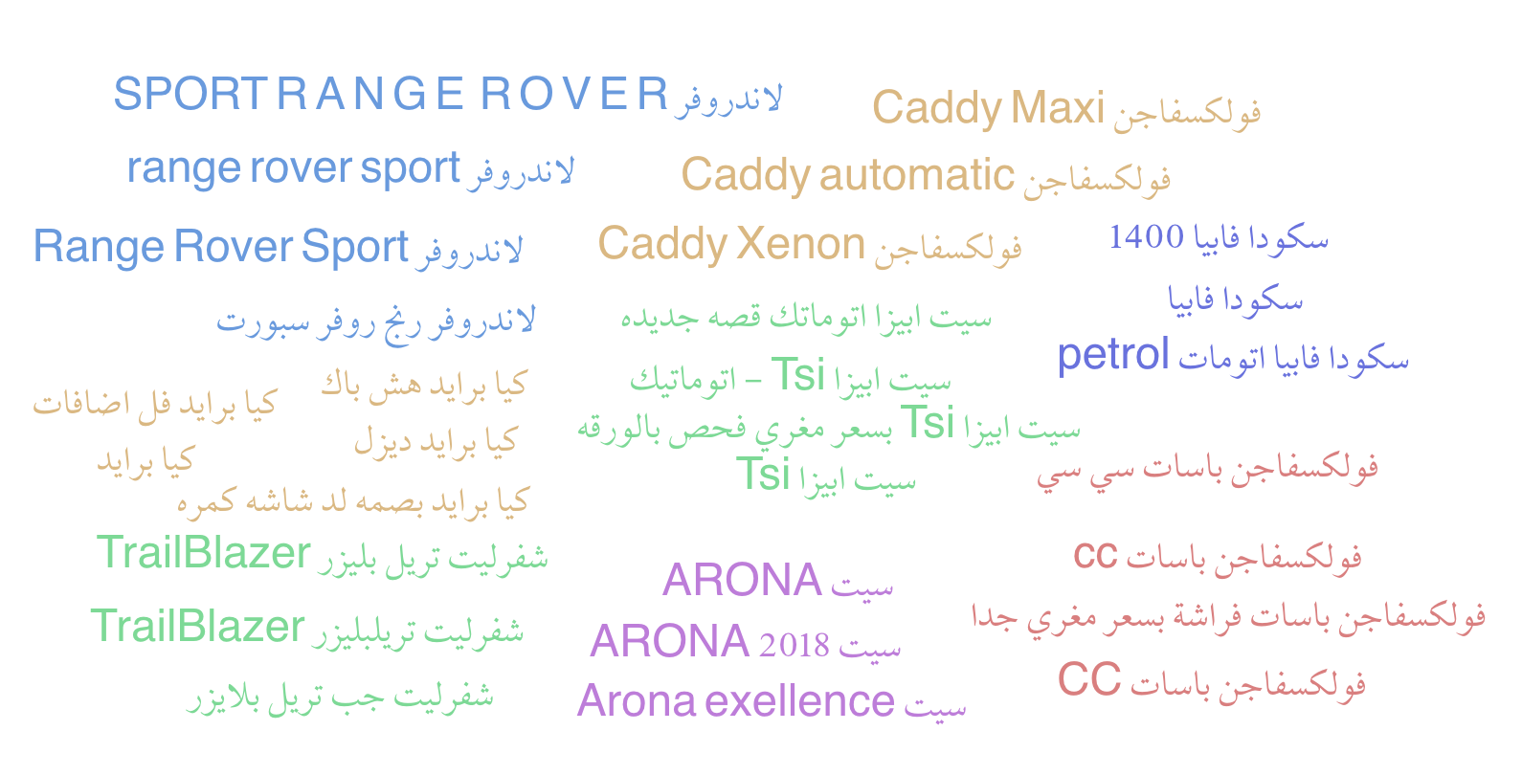
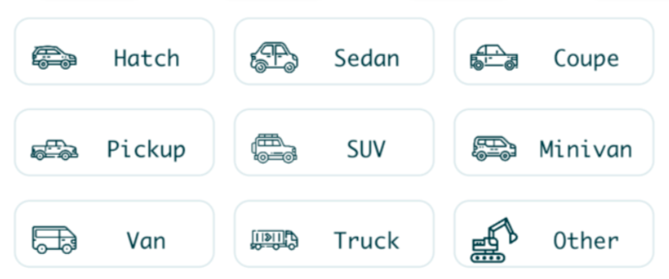
Car name
2. Re-Represent car name :
in three column make , model ,type.
3. Replace in Original file.
Type(body style)

Slide 24
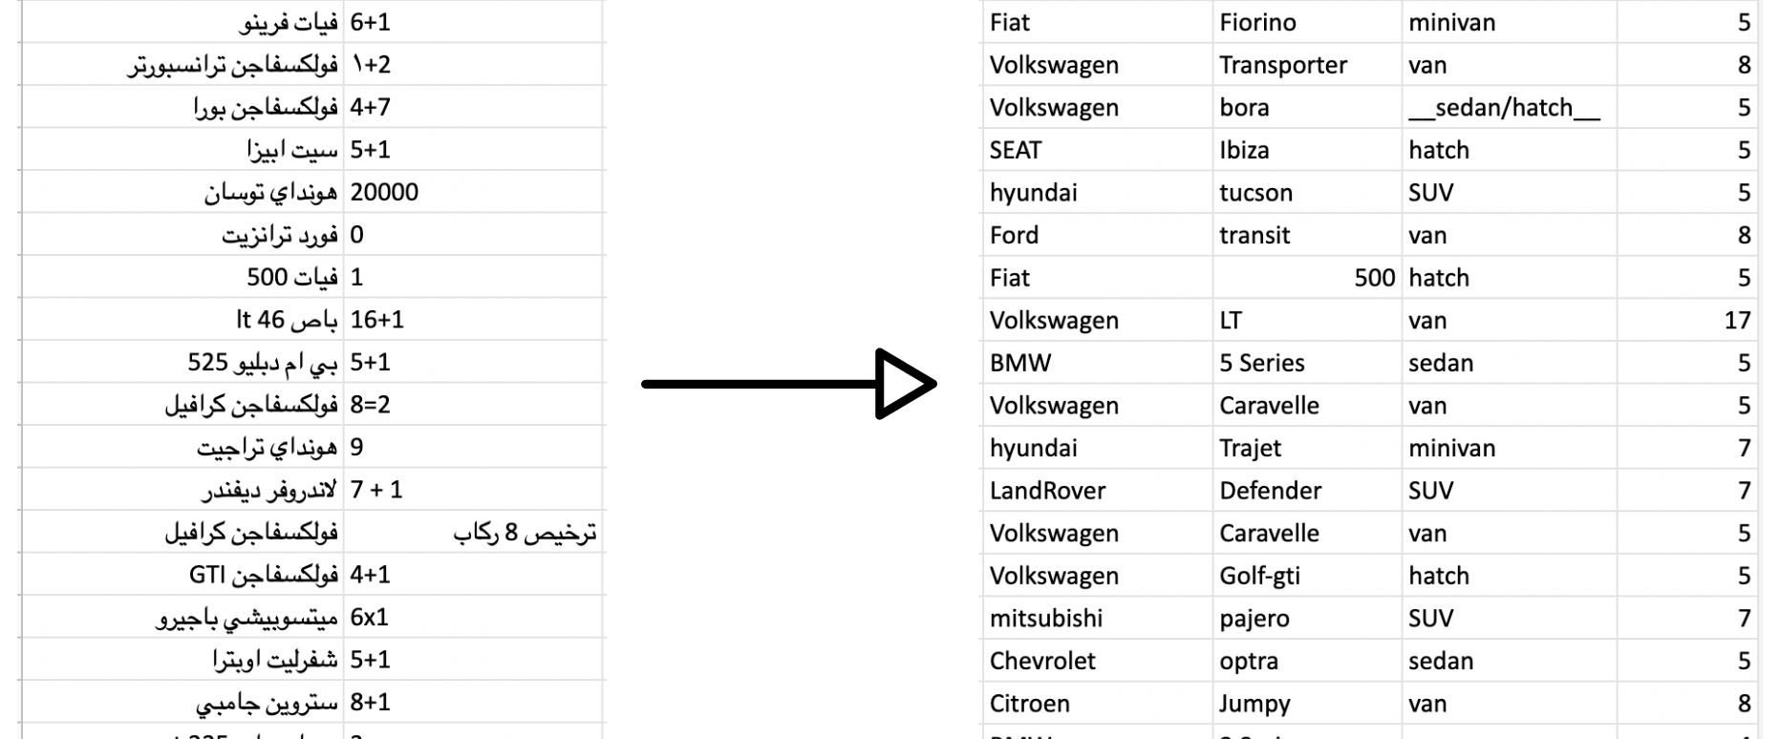
Car name

Slide 25
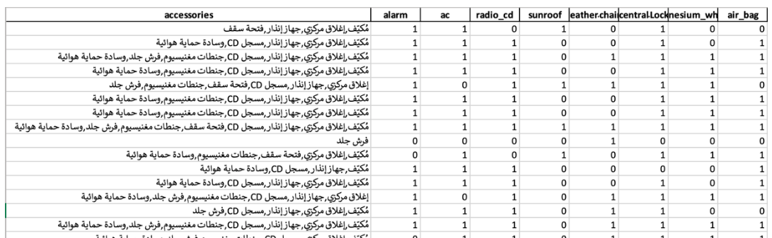
accessories
we generate a code that replace a text into a Boolean column so (1) will represent that vehicle contain this feature, (0) vehicle not contain this feature as follow ...

Slide 26
Day life
As a step to improve our project, we suggest to improve our data by adding a new feature that tells the age of this vehicle
today
2015/ 1/ 1
Example
-
year of production: 2015
Today: 2021/ 6/ 6
2344

Slide 27

PHASE 2

Slide 28
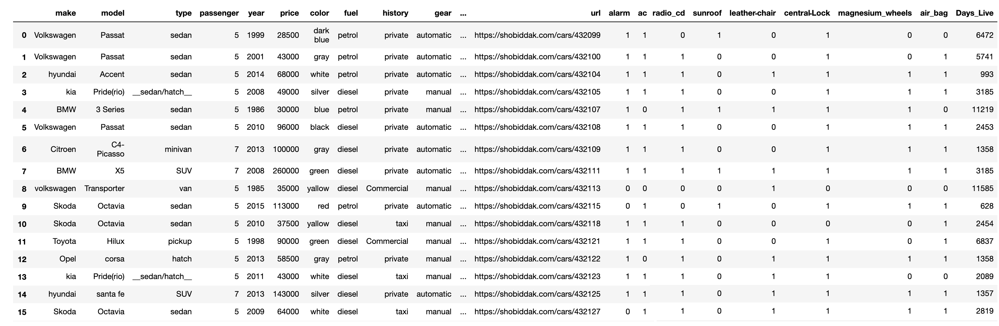
Final data after cleaning

Slide 29
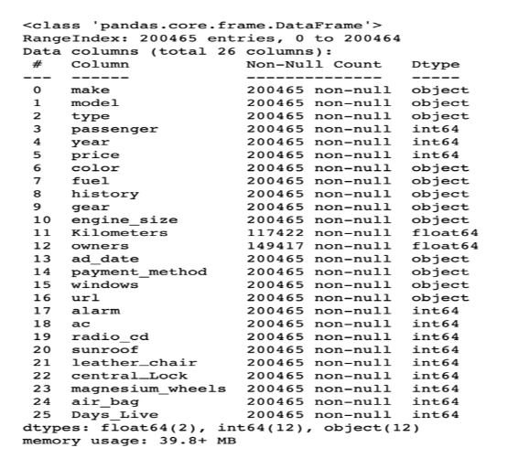
Final data after cleaning
The total Number of Data is 200465 and the total number of Features is 26
The Data is contain both Categorical and numeric value
There’s Some Missing Data in Some Column (Kilometers, owners)
So based in This Information we will Do some Prepossessing on Data To be Ready as follow ...
– ignore Some unnecessary Column(URL, ad date publish)
– encode the Categorical Data – impute Numeric Missing Data in (owners, Kilometers)

Slide 30
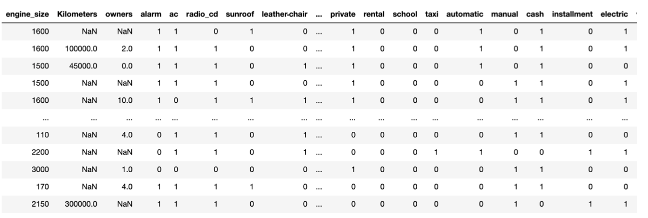
encode the Categorical Data
Data before encoding : 200465,26
Data after encoding : 200465,688

Slide 31
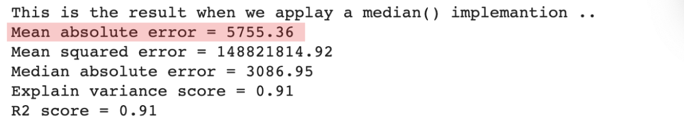
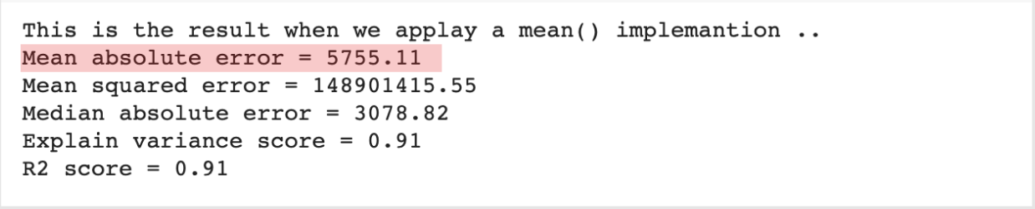
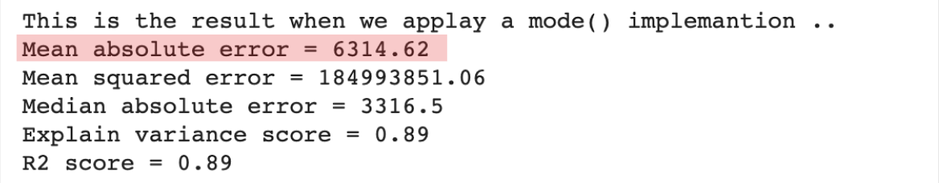
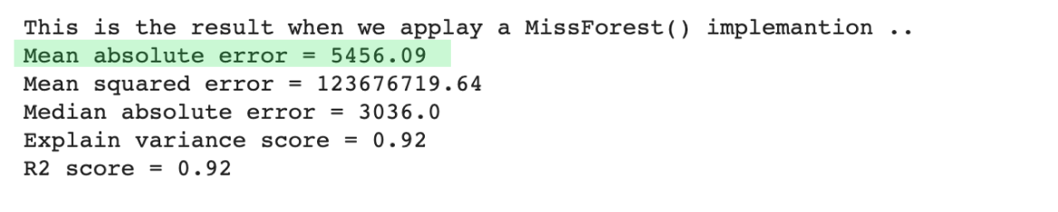
impute the Missing Data
result between imputation Technique that used

Slide 32
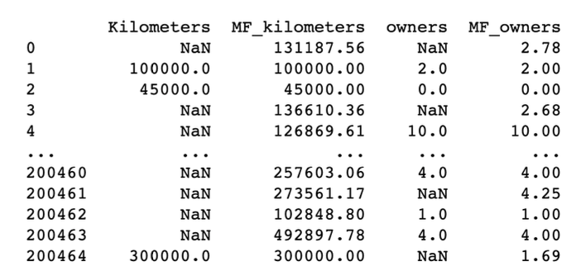
Miss-forest
Definition: ”Miss-forest is a non parametric imputation method for basically any kind of data. It can cope with mixed-type of variables, nonlinear relations, complex interactions and high dimensionality” .
Steps:
we must apply Encoded Technique in Categorical Data.
we Must split the Target value from the Data to a void Data Leak- age problem.
we perform the imputation in all Data. Then we create a new columns to use this imputation to fill Missing Data on it.

Slide 33
Data Graphical Representation

Slide 34
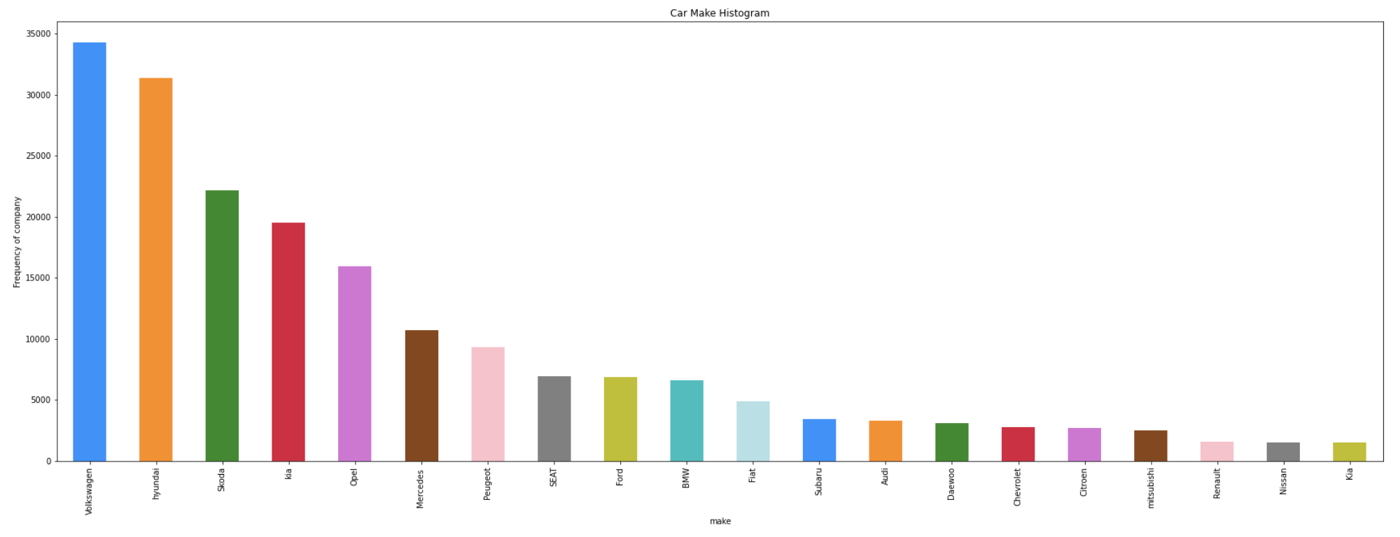
make

Slide 35
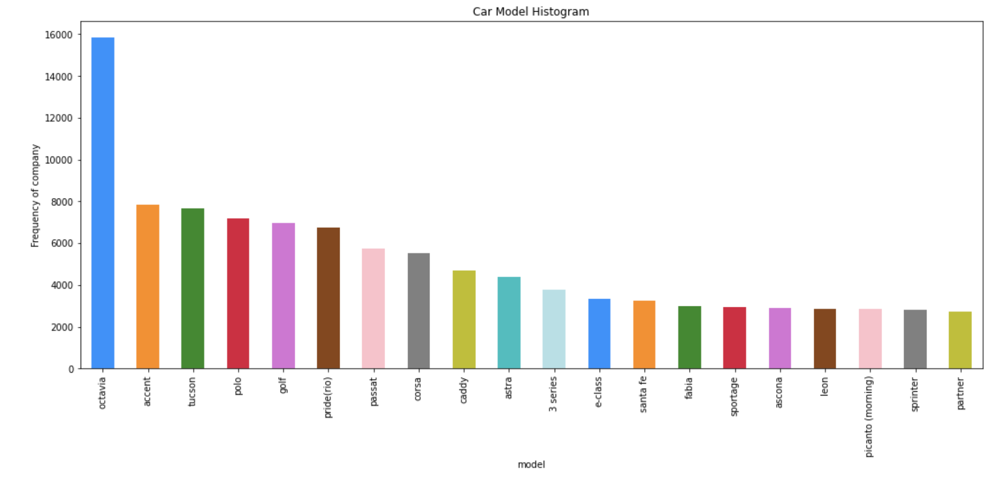
model

Slide 36
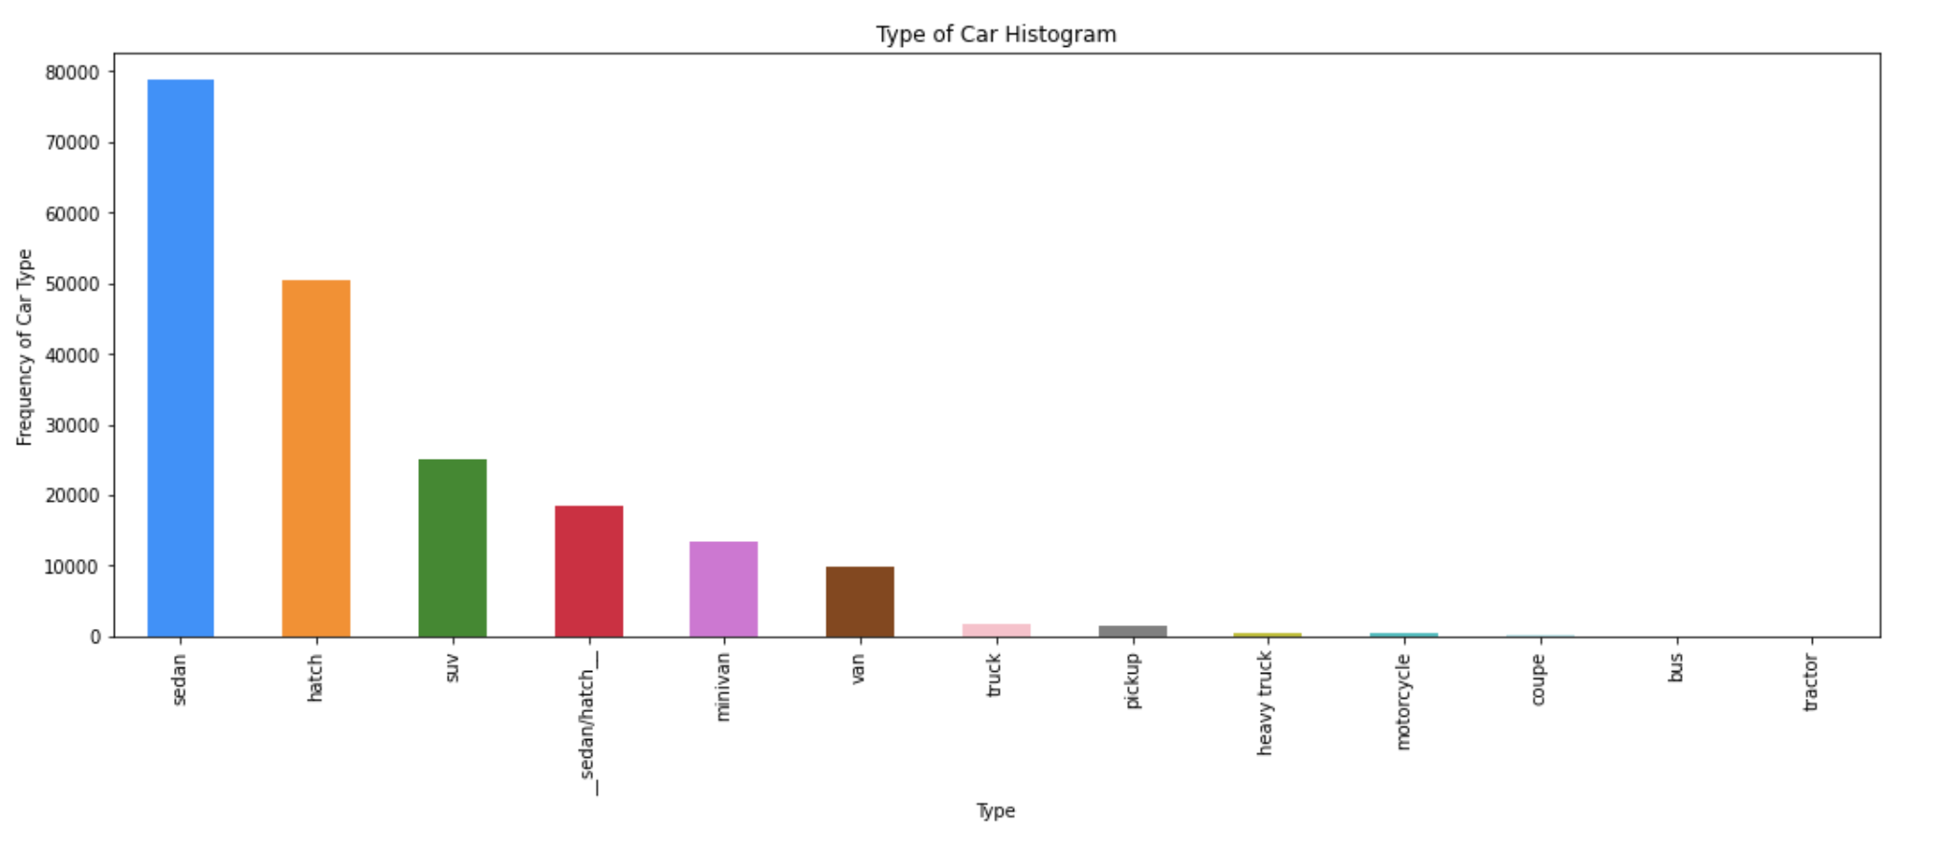
type

Slide 37
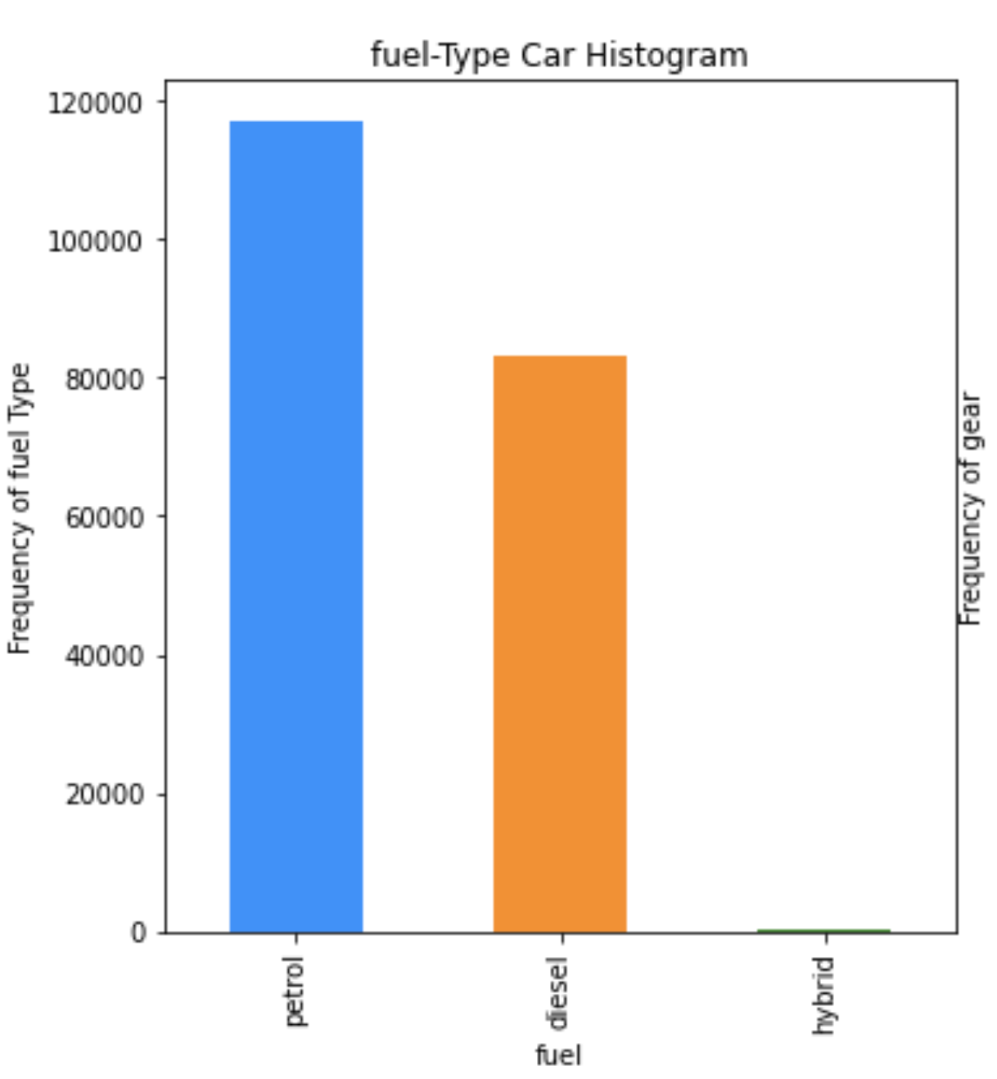
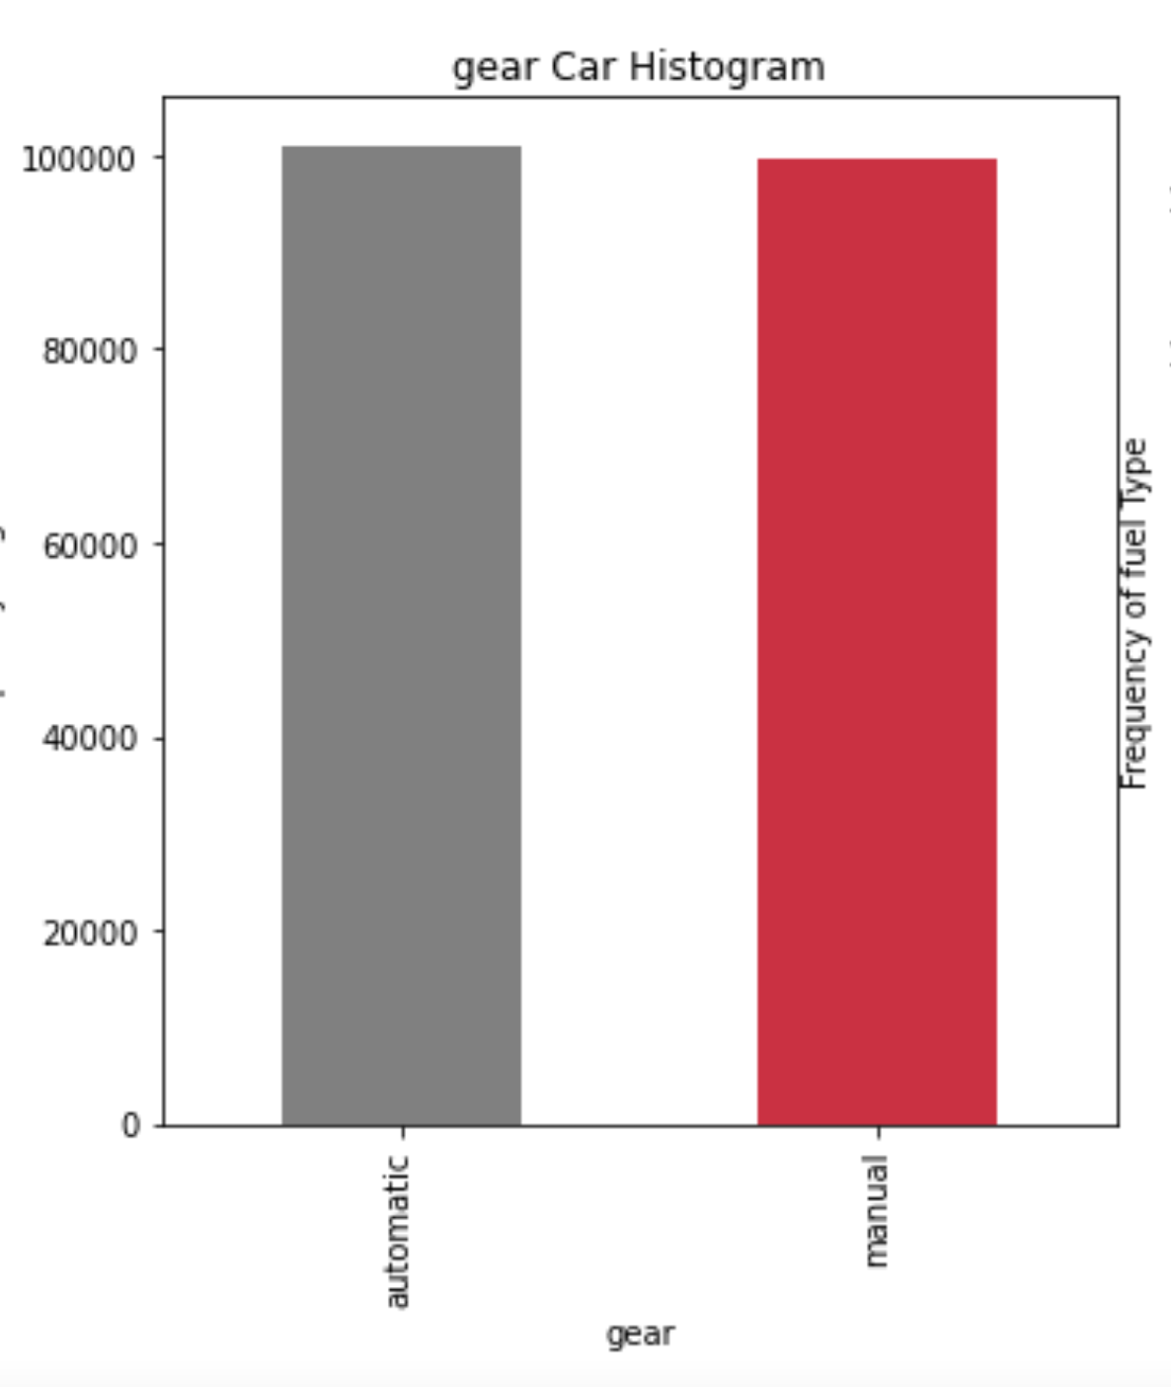
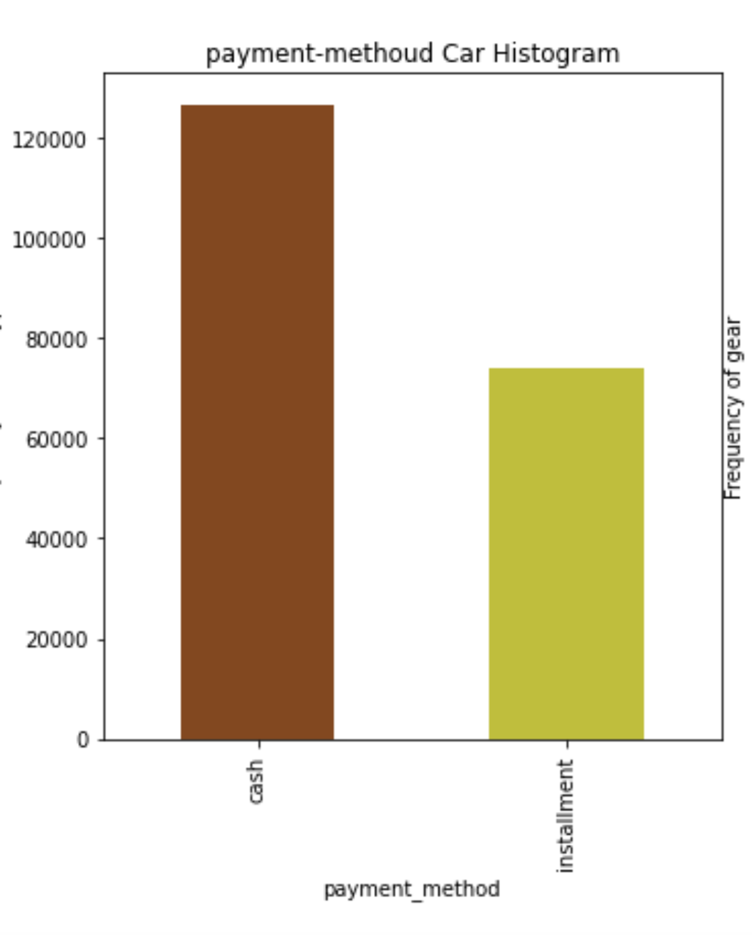
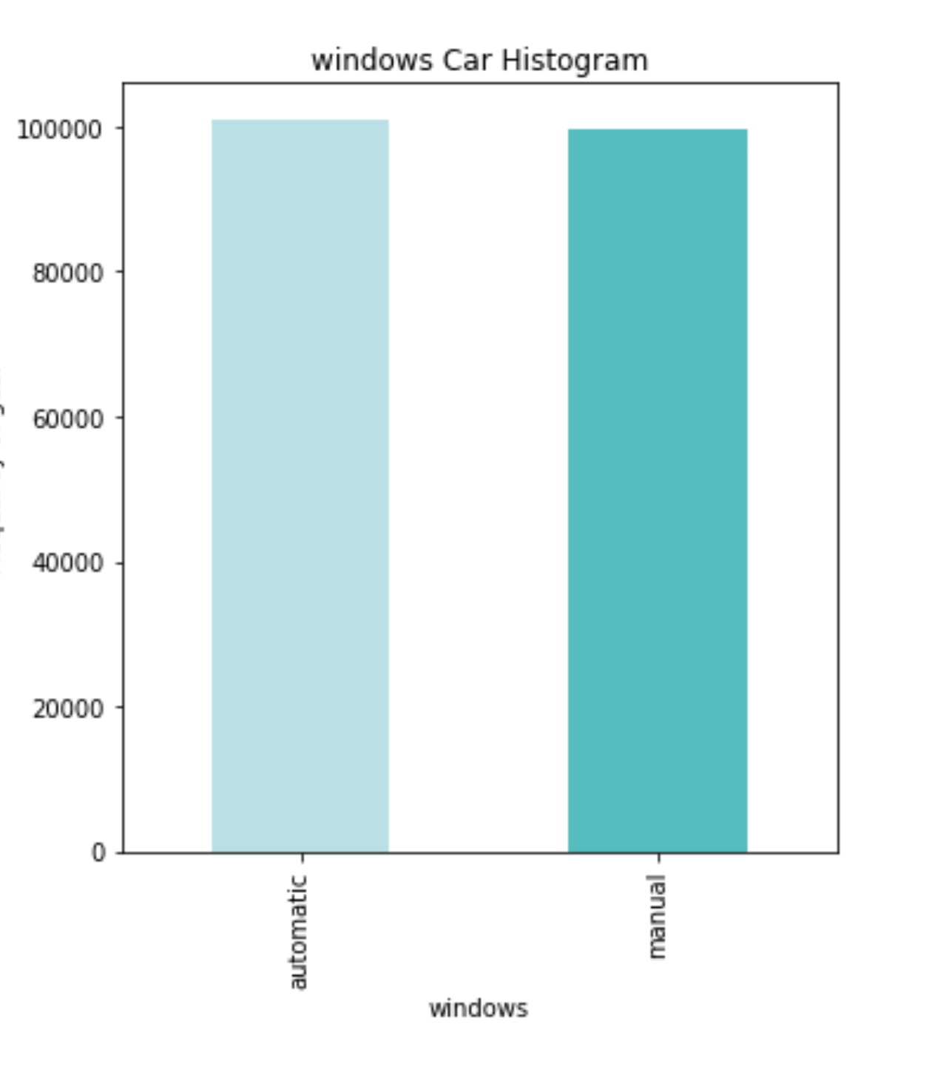

Slide 38
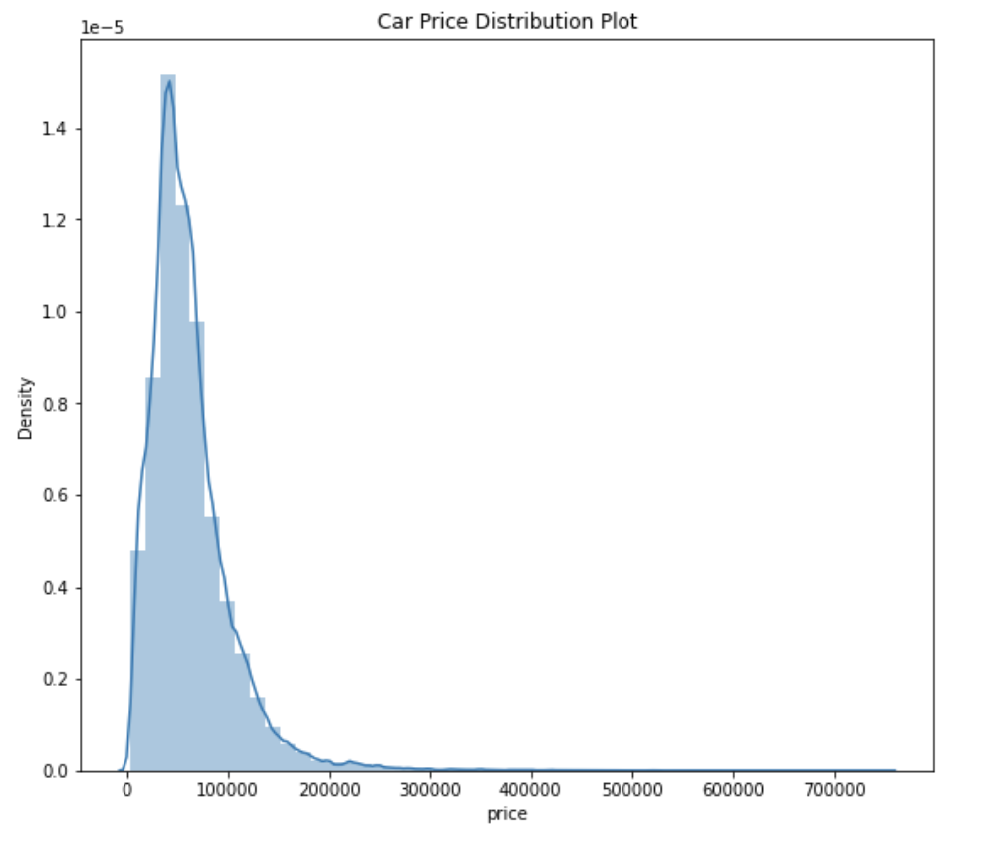
Price

Slide 39
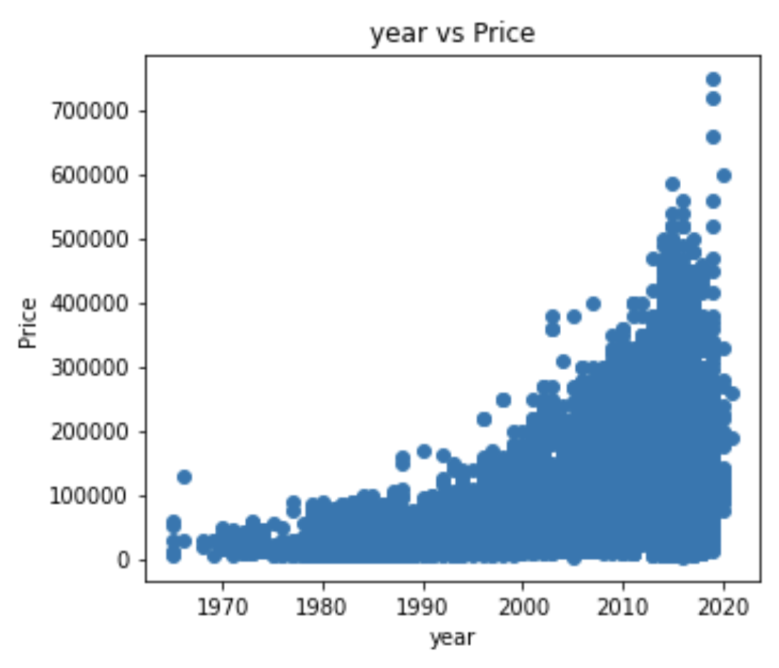
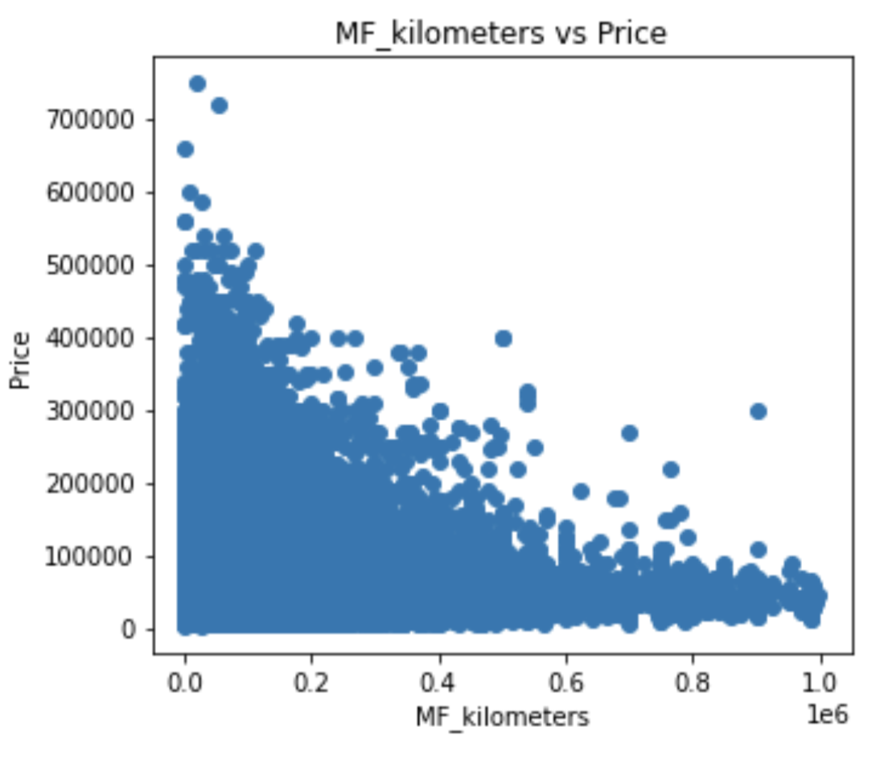
Correlation

Slide 40
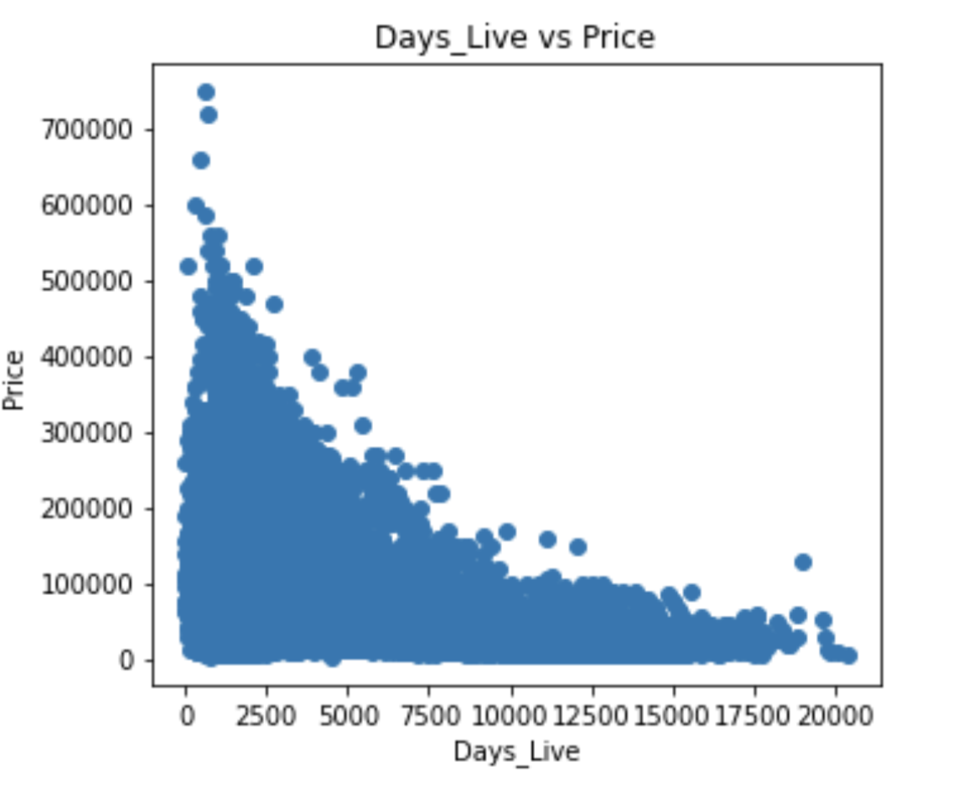
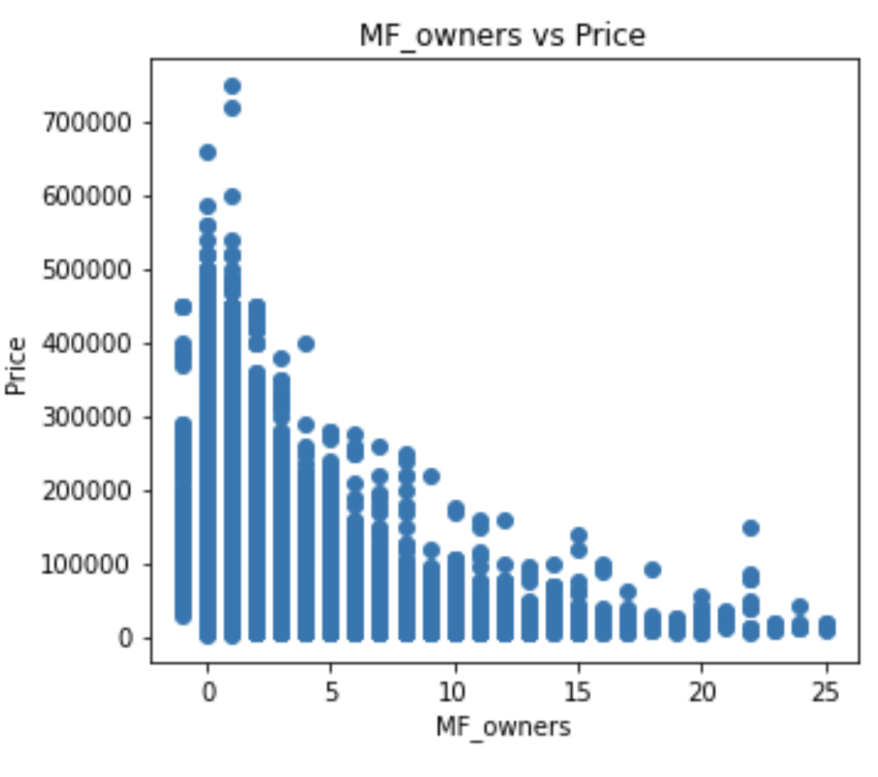
Correlation

Slide 41
Machine learning Result

Slide 42
RESULTS
 | OUTCOME
Algorithm | MAE | MSE | R2 score | Accuracy
Linear SVR | 0.0138 | 0.0007 | 0.76 | 76.10 %
K-neighbors Regressor | 0.0104 | 0.0004 | 0.86 | 82.47 %
Random Forest Regressor | 0.0072 | 0.0002 | 0.93 | 89.61 %
Gradient Boosting Regressor | 0.0097 | 0.0002 | 0.93 | 89.72 %
Deep Neural Networks | 0.0083 | 0.0002 | 0.92 | 89.68 %

Slide 43
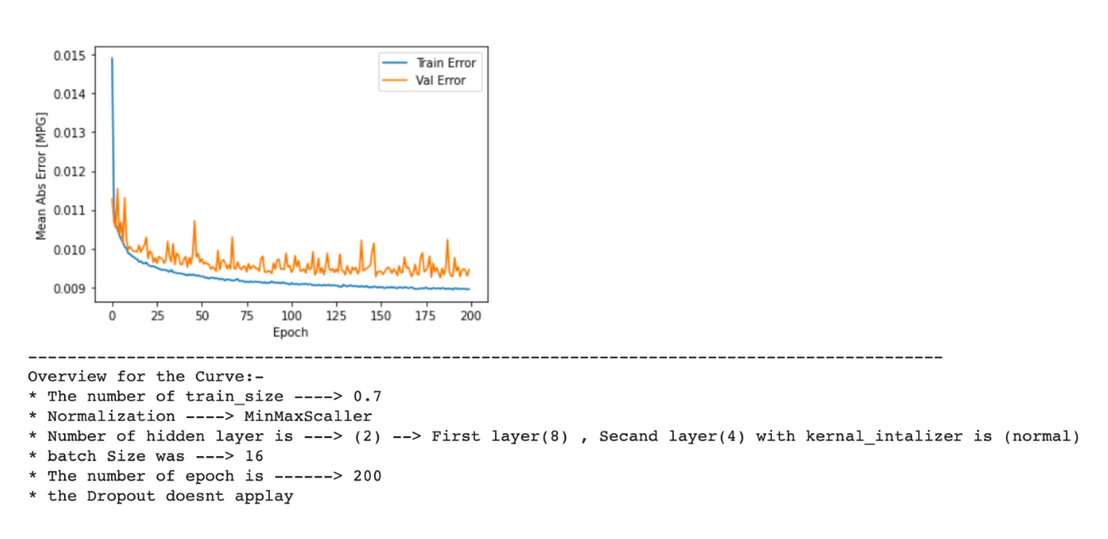
Deep Neural Networks
Neural Networks on 100k row

Slide 44
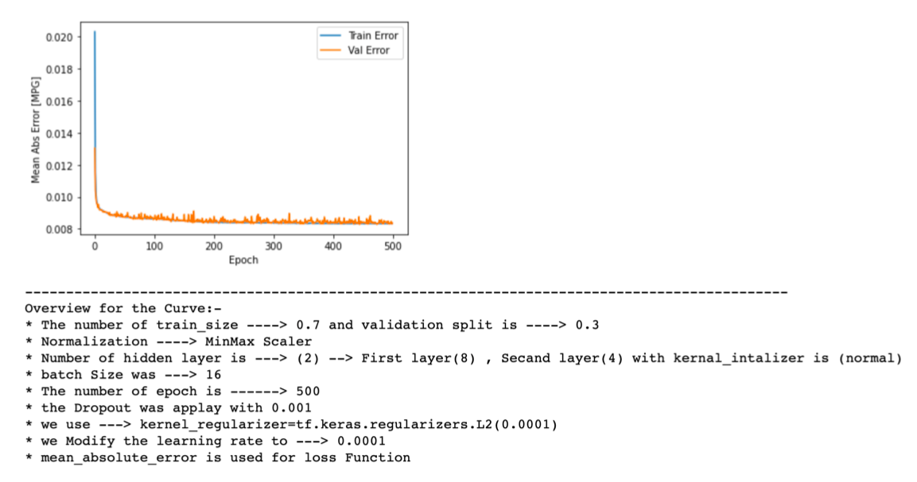
Deep Neural Networks
Evaluation result

Slide 45
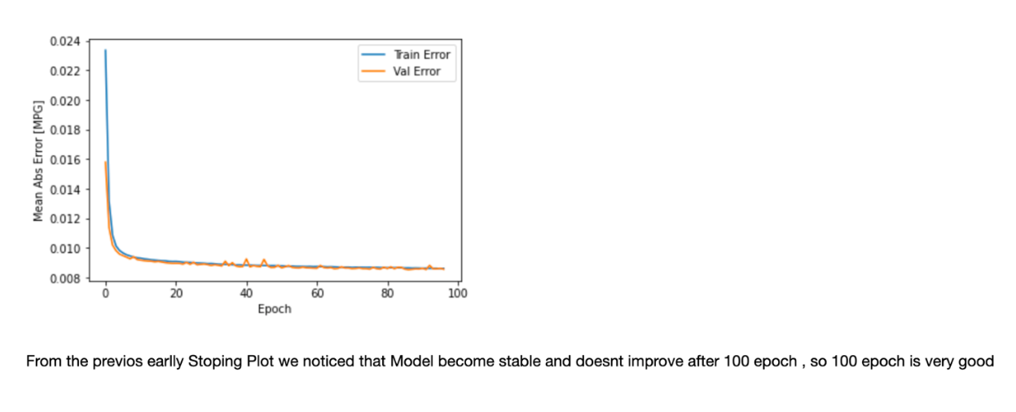
Deep Neural Networks
after early-stopping

Slide 46

SOUQY
APPLICATION

Slide 47
Brief
After collecting all the problems we noticed during the process of cleaning data and the problem with publishing car advertisement in all Palestinian website, we started to think seriously for create an application that Facilitates this task and solve all problem that we faced. In addition, we integrate a Machine learning Model that allows the user to check for the correct price before buying anything.

Slide 48
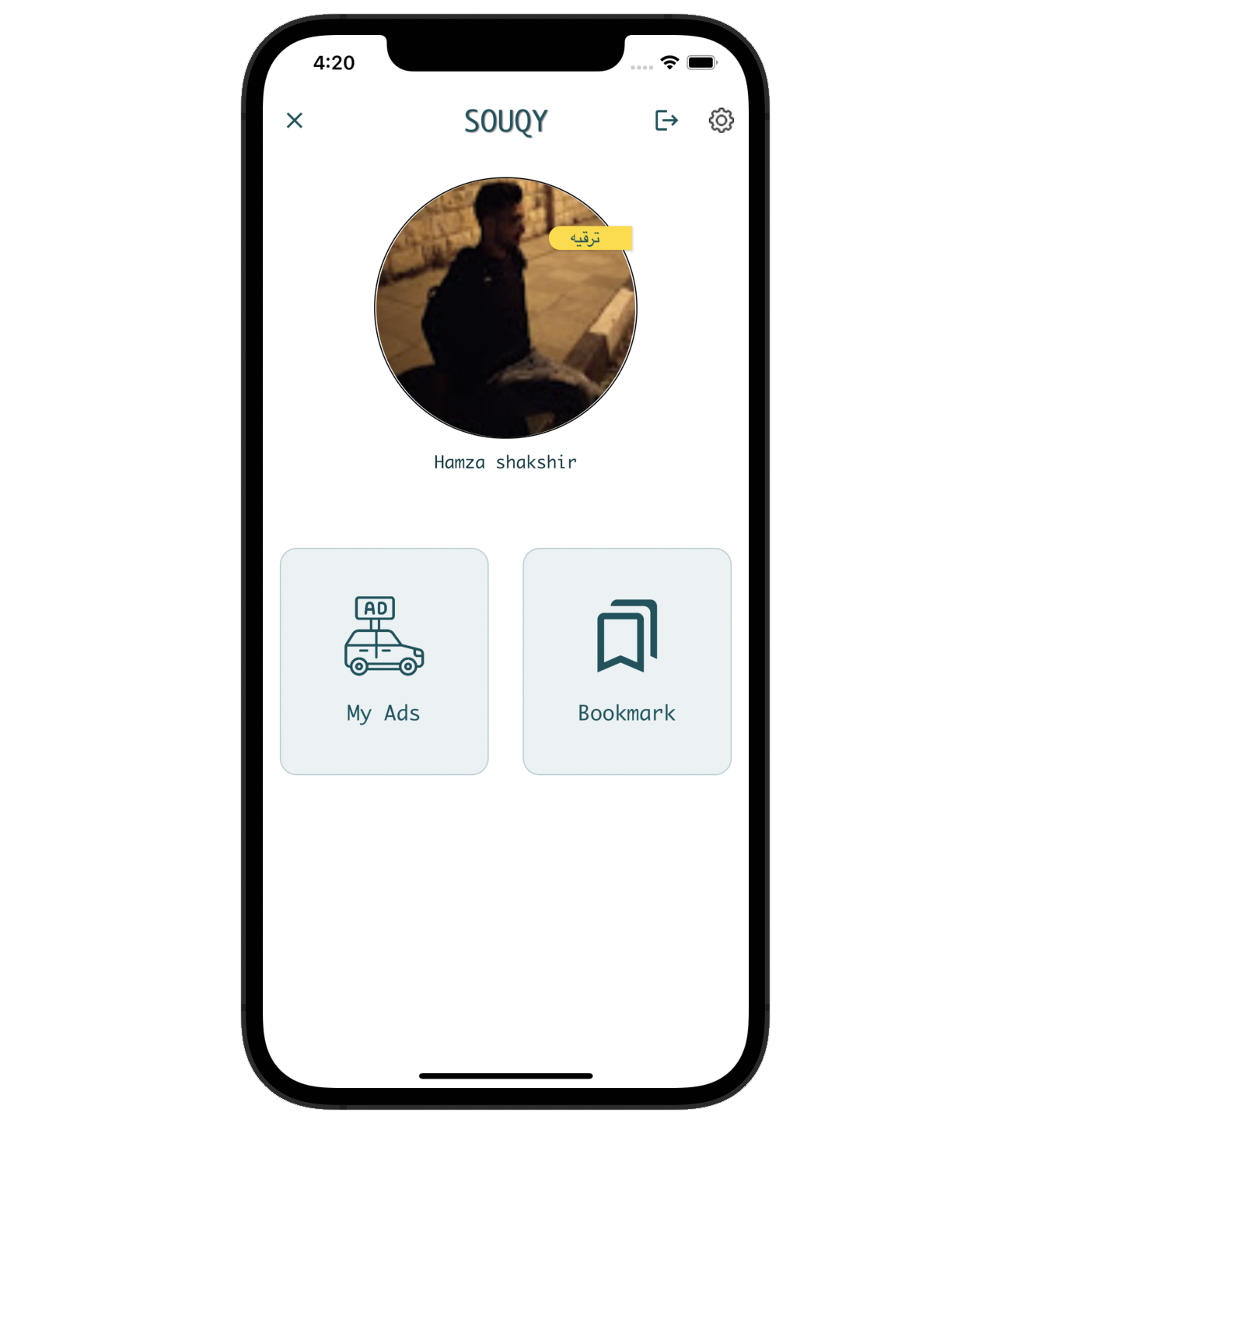
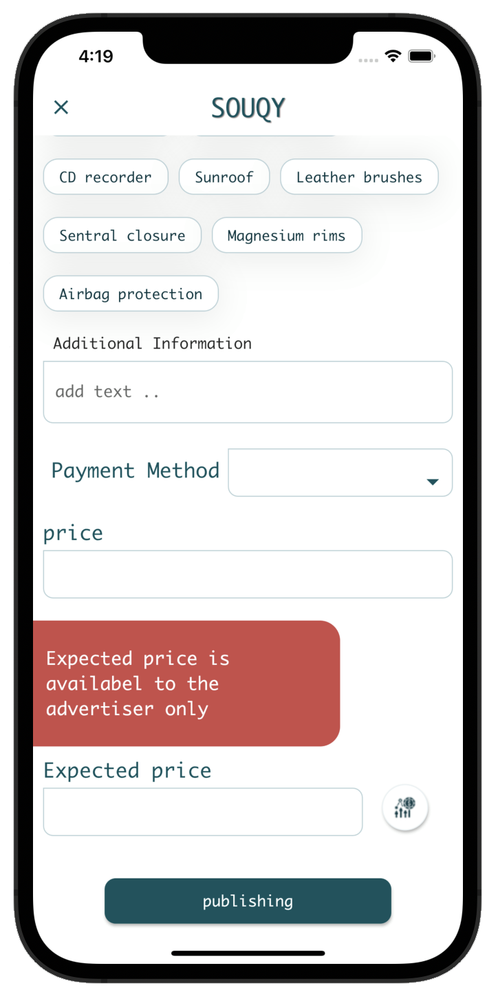
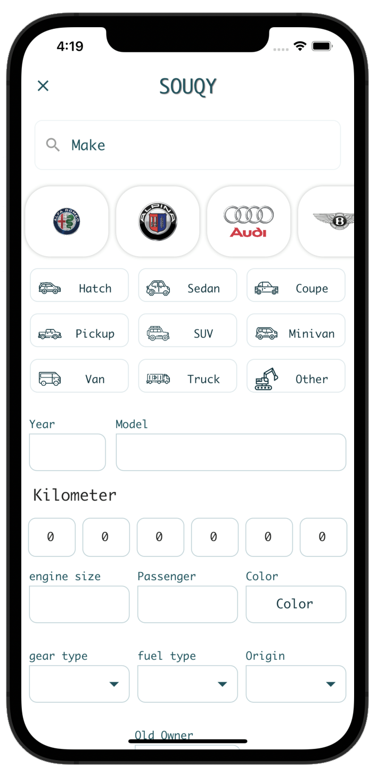
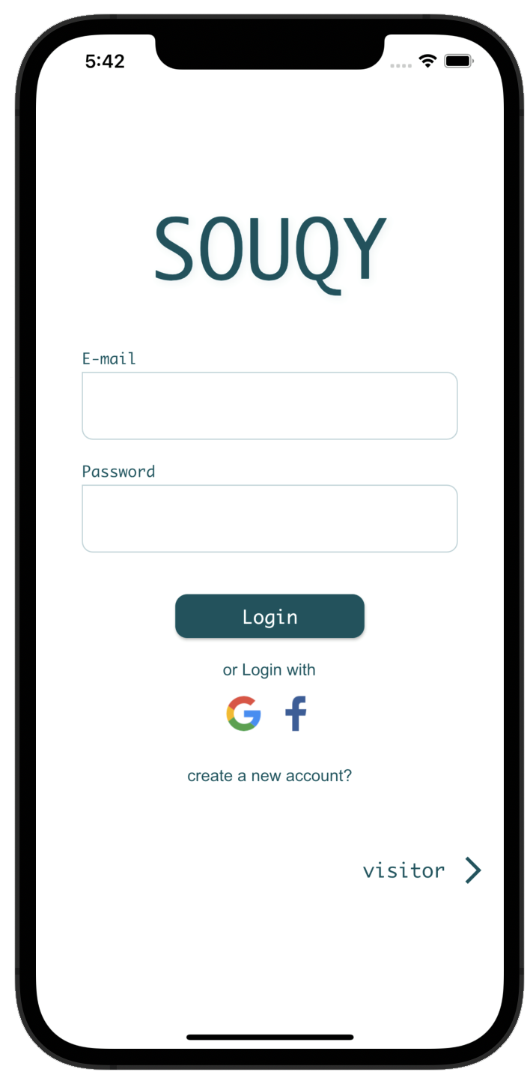
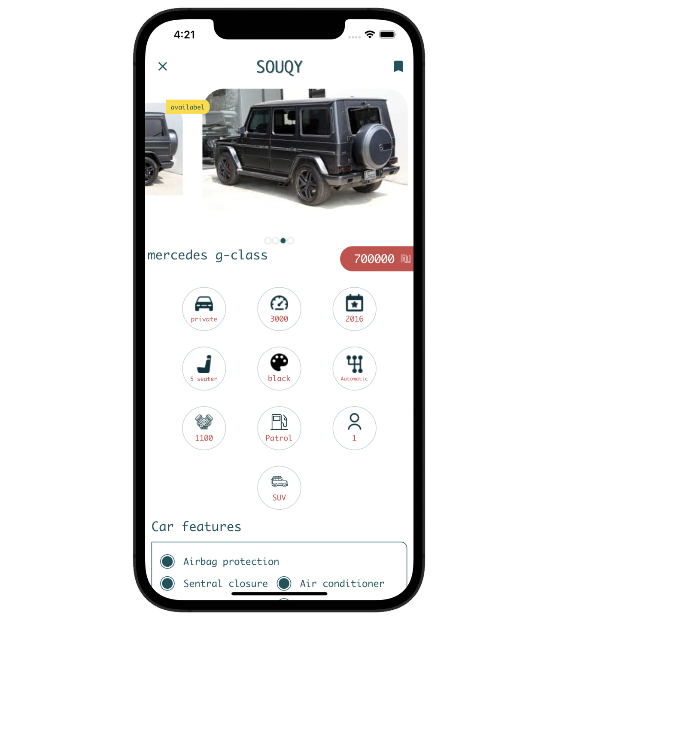
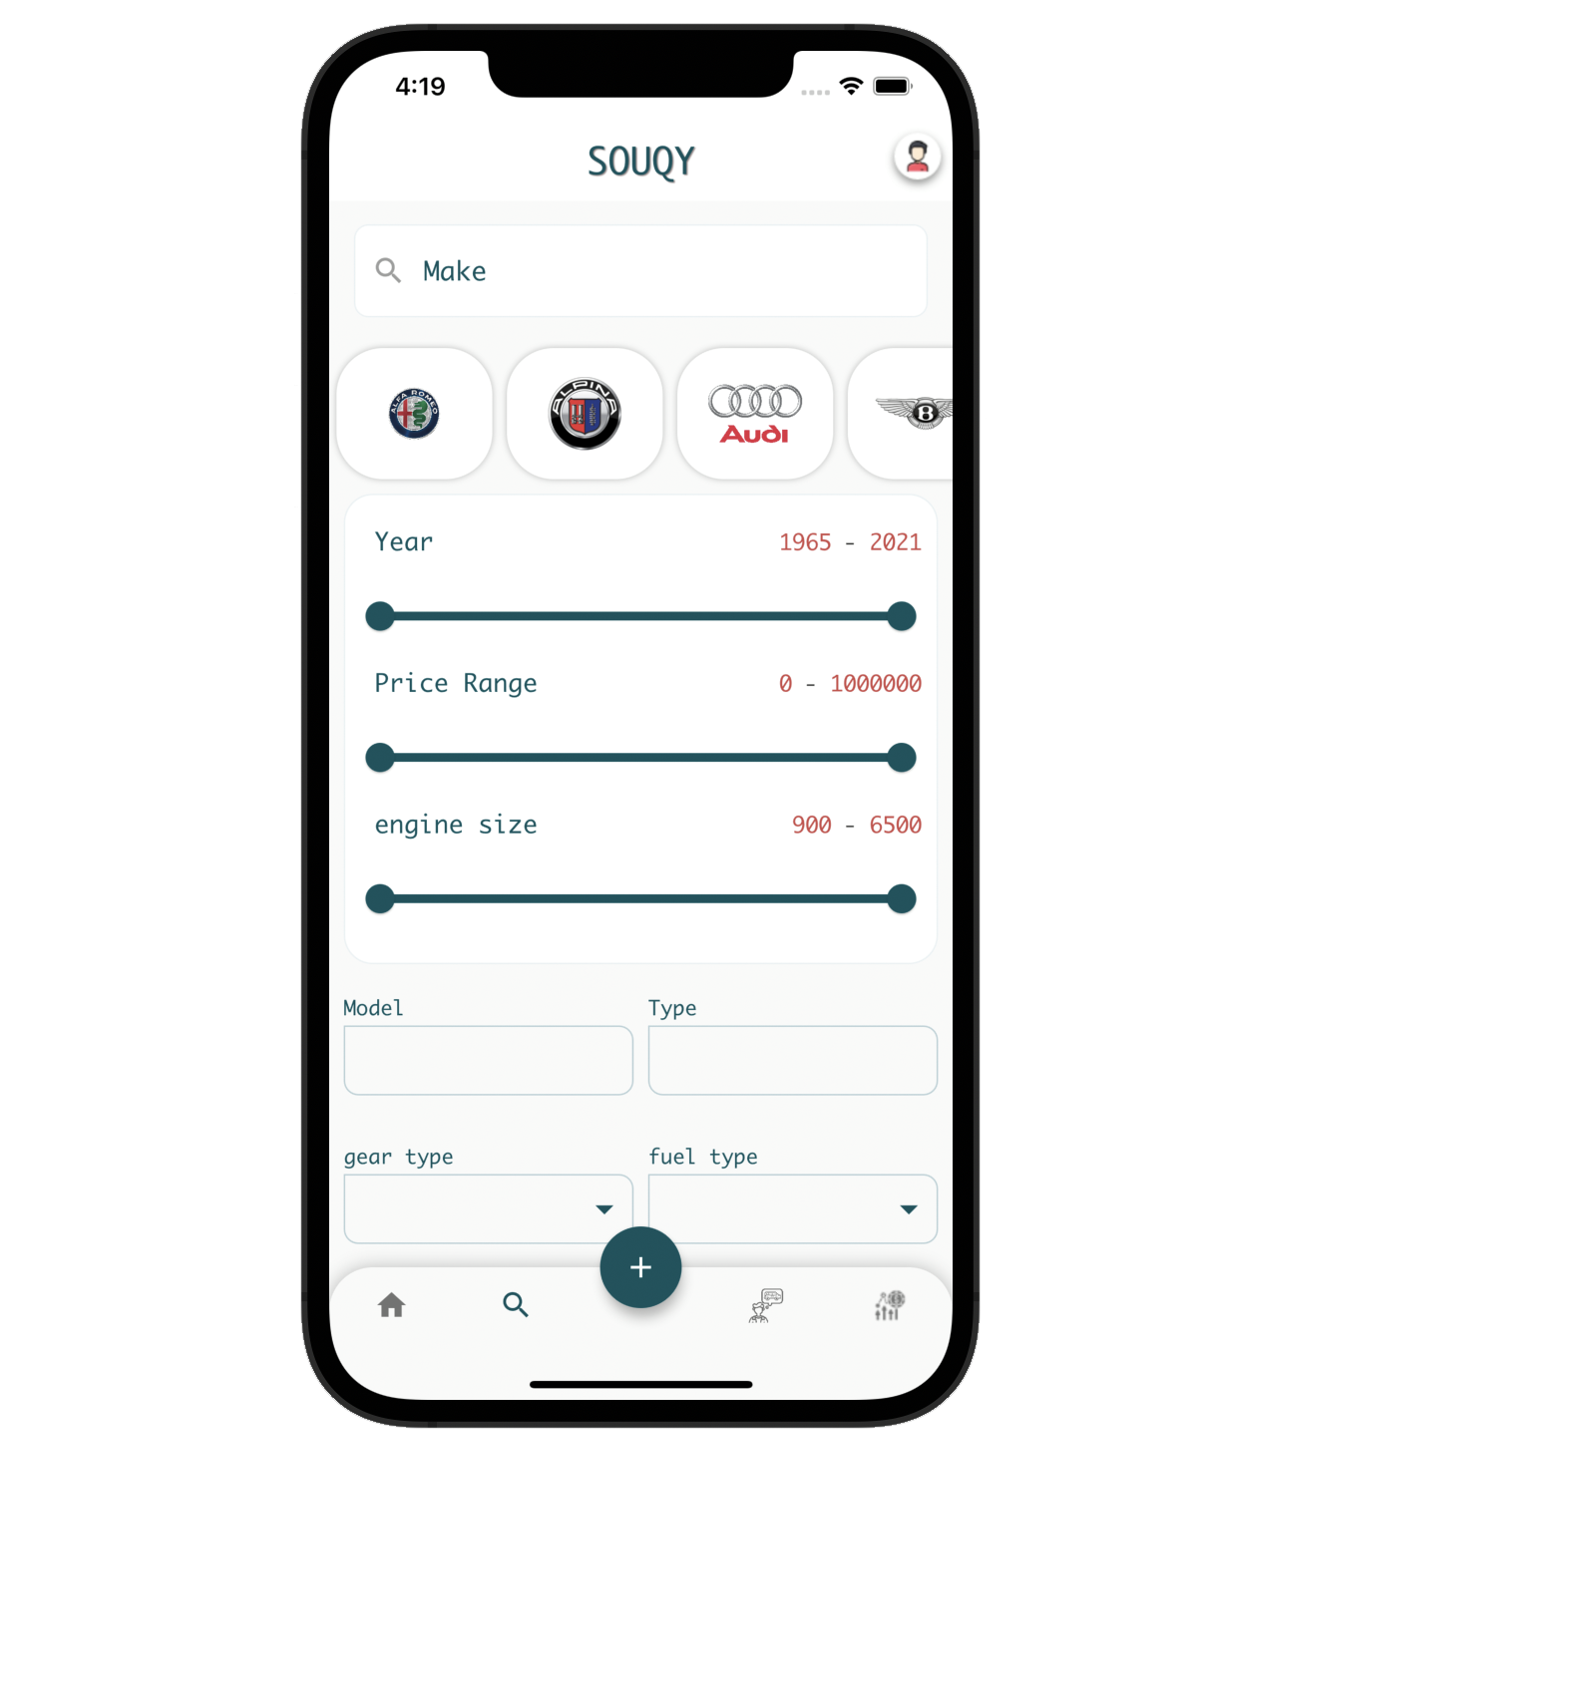

Slide 49
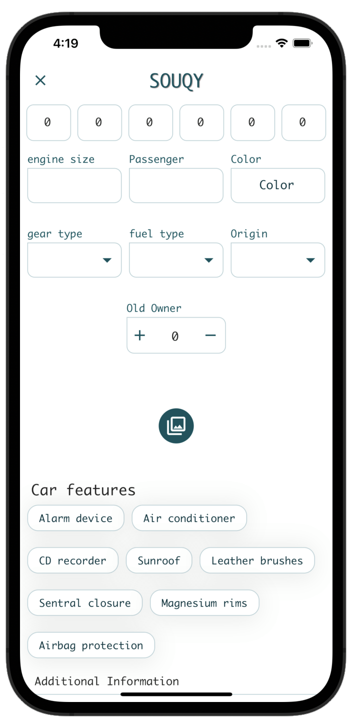
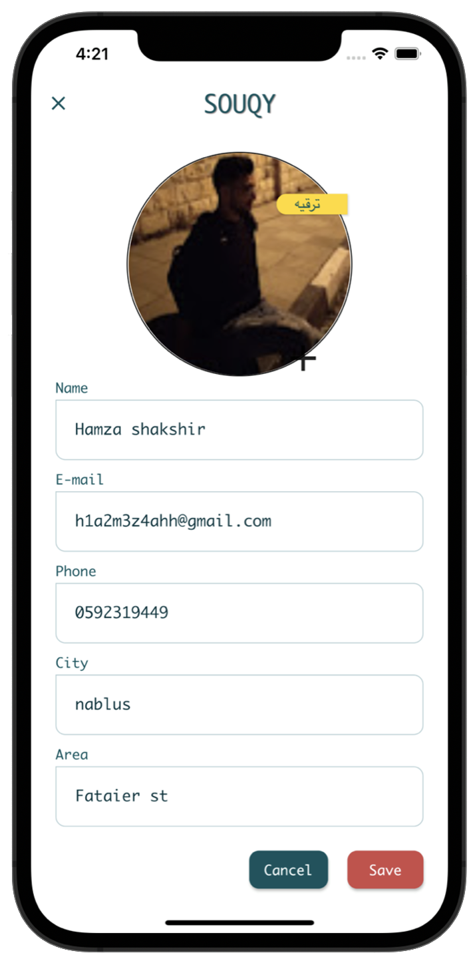

Slide 50
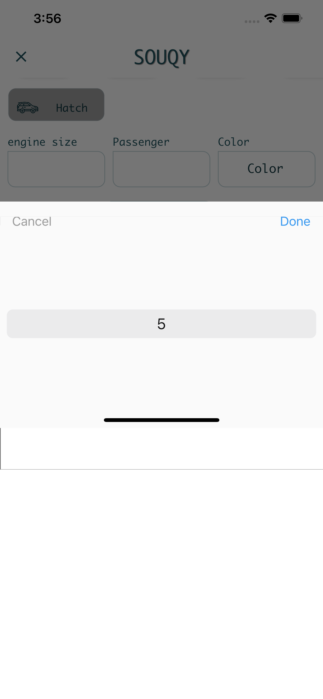
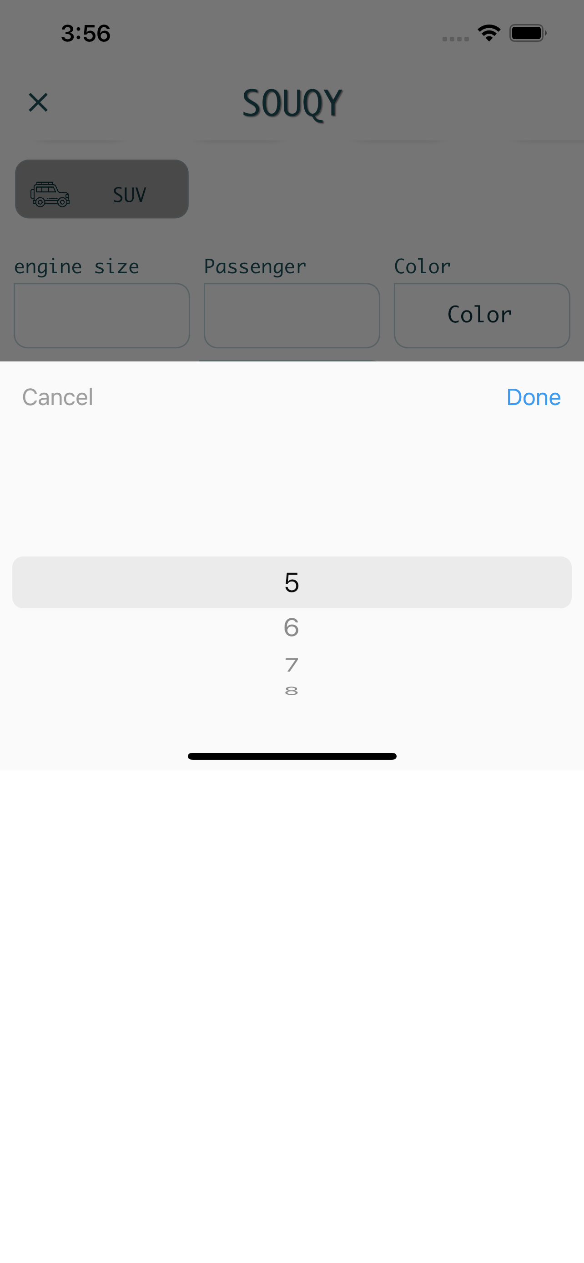

Slide 51
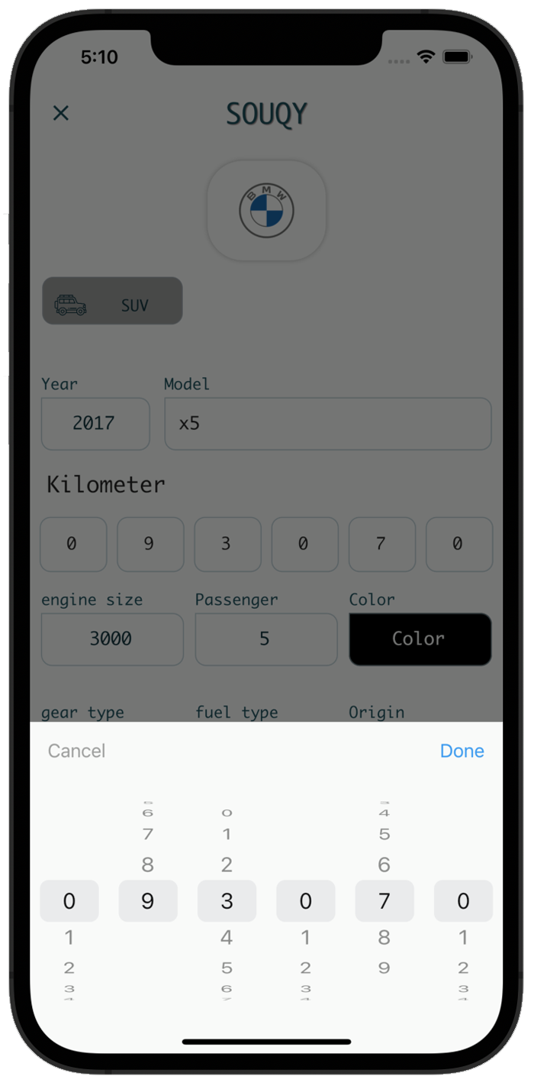
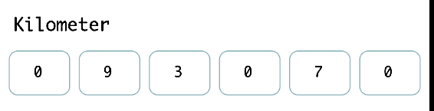
Kilometer

Slide 52








Development

Slide 53

python
Why?
Easy to use.
Community support.
Powerful library
Why?
Web Scraping.
Machine Learning.
Flask (backend app).

Slide 54

Flutter
What ?
Flutter is an open-source UI kit created by Google. It is used to develop cross platform applications for Android, iOS, Linux, Mac, Windows , website
Why?
cross platform.
Nice Ui kit
close performance to native
update reliable

Slide 55

Firebase
What ?
Development platform with real -time database and backend as a service.
Why?
Realtime Database.
Fast Development.
Authentication
Storge
Hosting
Performance
Analytics

Slide 56


Google colab
What ?
Cloud computing platform .
Why?
Support TensorFlow.
Powerful machine.
Support GPU and TPU.

Slide 57
Challenges
data
Training
flutter
no enough resources
restriction in publishing the advertisement
long time
Network failed
.
.
no previous experience
resources for learning

Slide 58
Future work
searching for more feature that affects the price will be the best goal to achieve such as (currency difference, state’s situation, text additional information that user provide in his advertisement such as سواقة سيدة, تامين جديد).] in addition, we will create different models that suggest the user to buy his suitable vehicle(Recommendation system)

Slide 59
Live demo

